Slide 1
Building Smart Apps with Microsoft Cognitive Services
Jeff Prosise
jeffpro@wintellect.com

Slide 2

Microsoft Cognitive Services
Intelligence APIs for building intelligent apps

Slide 3
Cognitive Services APIs
Vision
Computer Vision
Content
Moderator
Emotion
Face
Video
Speech
Bing Speech
Custom Recognition
Speaker Recognition
Language
Bing
Spell Check
Language Understanding
Linguistic Analysis
Text Analytics
Translator
Web Language Model
Knowledge
Academic Knowledge
Entity Linking
Knowledge Exploration
QnA Maker
Recom-mendations
Search
Bing Auto-suggest
Bing Image Search
Bing News Search
Bing Video Search
Bing Web Search

Slide 4
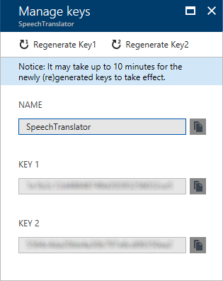
Subscription Keys
Obtained from the Azure Portal
Requires an Azure subscription, but doesn't necessarily cost you to make calls
Trial subscriptions for free at https://azure.microsoft.com/en-us/free/

Slide 5
Demo
Obtaining a Subscription Key
Notes:
Go into the Azure Portal and demonstrate how to subscribe to an API and obtain a subscription key.

Slide 6
Vision APIs
Computer Vision
Content
Moderator
Emotion
Face
Video
Detect faces, objects, and colors in images
Generate captions and metadata
Read text (OCR)
Generate "smart" thumbnails
Analyze images for potentially offensive content or text
Optionally include human review
Detect faces in images
Identify emotions in faces: anger, fear, disgust, contempt, happiness, sadness, and surprise
Detect faces
Identify faces
Identify similar faces
Identify a person's age, gender, and more from a photograph
Stabilize videos
Detect and track faces in videos
Detect motion in videos
Generate "smart" thumbnails
Notes:
Uber uses the Face API to verify drivers and says "the response time is incredible."

Slide 7
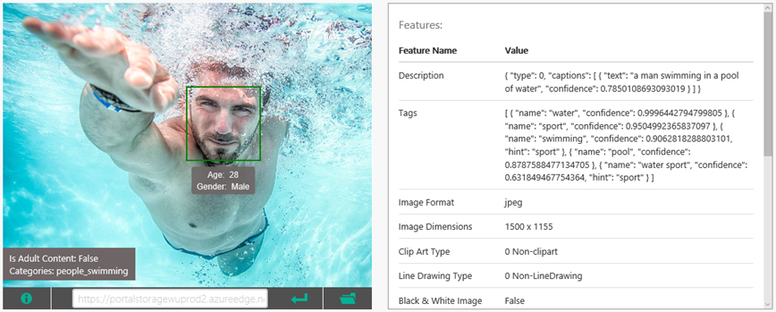
Computer Vision API
Returns information about content in images
Colors, objects, captions, faces, "raciness," and more
Notes:
The Computer Vision API, part of Cognitive Services, offers methods for captioning images, generating metadata keywords, recognizing celebrities, reading text, and generating "smart" thumbnails. It can also detect faces in images, identify age and gender, and recognize thousands of celebrities and landmarks. For more information, visit https://www.microsoft.com/cognitive-services/en-us/computer-vision-api.

Slide 8
Computer Vision API Methods
analyze
Detects features such as faces and offensive content
describe
Generates an image description and a collection of tags
generateThumbnail
Generates a "smart" thumbnail of the specified size
ocr
Extracts text from an image
recognizeText
Extracts handwritten text from an image
tag
Generates a list of words (tags) describing an image

Slide 9

Captioning an Image
POST /vision/v1.0/analyze?visualFeatures=Description HTTP/1.1
Content-Type: application/json
Host: westus.api.cognitive.microsoft.com:443
Ocp-Apim-Subscription-Key: ••••••••••••••••••••••••••••••••
{"url":"https://intellipix.blob.core.windows.net/photos/Dubai.jpg"}
Notes:
Images can be passed by URL or as byte streams. This example uses a URL.

Slide 10
JSON Output
{
"description": {
"tags": [ "man", "dune", "riding", "board", "hill", ..., "sand" ],
"captions": [
{
"text": "a man riding a skateboard in the sand",
"confidence": 0.66107721083049154
}
]
},
"requestId": "03501f93-a0ba-4205-a778-6e02cce2b509",
"metadata": {
"width": 3072,
"height": 2304,
"format": "Jpeg"
}
}
Notes:
As shown here, the description method returns one or more image captions, a collection of tags, and metadata information such as the image's format, width, and height.

Slide 11
Captioning an Image (C# with SDK)
var client = new VisionServiceClient("subscription_key");
var features = new VisualFeature[] { VisualFeature.Description };
var result = await client.AnalyzeImageAsync (
"https://intellipix.blob.core.windows.net/photos/Dubai.jpg"},
features
);
string caption = result.Description.Captions[0].Text);
foreach (string tag in result.Description.Tags)
{
// tag holds descriptive tag for image (e.g., "sand")
}
Notes:
This example passes an image by its URL. Images can also be passed in byte streams.

Slide 12
Captioning an Image (Node.js)
var options = {
url: "https://westus.api.cognitive.microsoft.com/vision/v1.0/analyze",
qs: { visualFeatures: "Description" },
method: "POST",
headers: {
"Content-Type": "application/json",
"Ocp-Apim-Subscription-Key": "subscription_key"
},
body: { url: "https://intellipix.blob.core.windows.net/photos/Dubai.jpg" },
json: true
};
request(options, function(err, response, result) {
if(!err) {
var caption = result.description.captions[0].text;
}
});

Slide 13
Analyzing an Image for Adult Content
POST /vision/v1.0/analyze?visualFeatures=Adult HTTP/1.1
Content-Type: application/json
Host: westus.api.cognitive.microsoft.com:443
Ocp-Apim-Subscription-Key: ••••••••••••••••••••••••••••••••
{"url":"https://intellipix.blob.core.windows.net/photos/Dubai.jpg"}

Slide 14
JSON Output
{
"adult": {
"isAdultContent": false,
"isRacyContent": false,
"adultScore": 0.0092171626165509224,
"racyScore": 0.016372650861740112
},
"requestId": "2e4fbfee-c55d-4648-b914-764f38133934",
"metadata": {
"width": 3072,
"height": 2304,
"format": "Jpeg"
}
}

Slide 15
Demo
Computer Vision API
Notes:
Show Intellipix and demonstrate how it uses the Computer Vision API to caption photos and generate search metadata. Then demonstrate how to use Azure Functions to score uploaded photos for potentially offensive content.

Slide 16
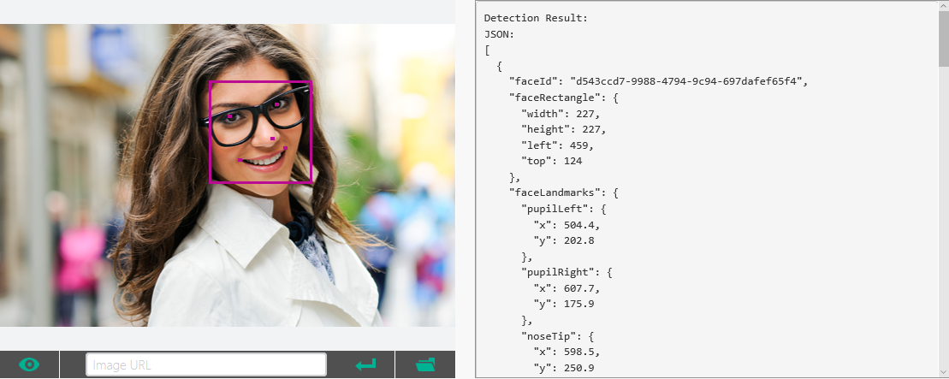
Face API
Detect and identify faces in photos
Identify age, gender, emotion, and more

Slide 17
Face API Methods
Detects faces and emotions, identifies facial features, age, gender, and more
detect
findsimilars
Given a face, finds similar-looking faces from a group of faces
group
Groups faces based on similarity
identify
Given a face, identifies the owner from a group of faces
verify
Compares two faces and scores their similarity
Also contains methods for creating face lists and person groups

Slide 18

Identifying Age and Gender
POST /face/v1.0/detect&returnFaceAttributes=age,gender HTTP/1.1
Content-Type: application/json
Host: westus.api.cognitive.microsoft.com:443
Ocp-Apim-Subscription-Key: ••••••••••••••••••••••••••••••••
{"url":"https://intellipix.blob.core.windows.net/photos/P1010909.JPG"}

Slide 19
JSON Output
[
{
"faceRectangle": {
"top": 287, "left": 708, "width": 206, "height": 206
},
"faceAttributes": { "gender": "female", "age": 39.9 }
},
{
"faceRectangle": {
"top": 296, "left": 557, "width": 183, "height": 183
},
"faceAttributes": { "gender": "male", "age": 6.3 }
}
]

Slide 20
Demo
Face API
Notes:
Show FaceVerifier, which verifies my identity using a photo.

Slide 21
Language APIs
Bing
Spell Check
Language
Understanding
Linguistic
Analysis
Text
Analytics
Translator
Correct misspelled words
Proof documents
Correct case errors
Teach apps to understand commands from users
Build bots that converse naturally with users
Extract meaning from text
Identify actions and objects of those actions
Identify topics in text
Extract key phrases
Identify sentiment
Translate speech to text in other languages in real time
Perform TTS on translated text

Slide 22
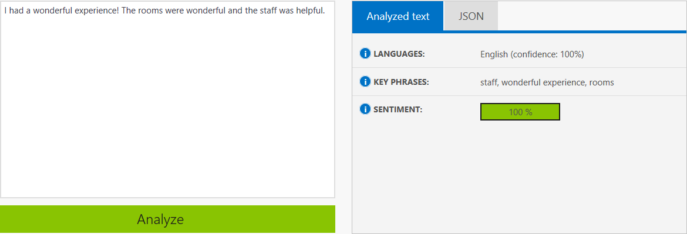
Text Analytics API
Detect topics, language, and extract key phrases
Analyze sentiment expressed in text

Slide 23
Text Analytics API Methods
languages
Identify language from more than 120 supported languages
topics
Generates a list of topics detected in input text
keyPhrases
Generates a list of key phrases detected in input text
sentiment
Scores input text for sentiment (0.0 to 1.0)

Slide 24
Analyzing Text for Sentiment
POST /text/analytics/v2.0/sentiment HTTP/1.1
Content-Type: application/json
Host: westus.api.cognitive.microsoft.com:443
Ocp-Apim-Subscription-Key: ••••••••••••••••••••••••••••••••
{
"documents": [
{
"id": "1000",
"text": "I am mostly happy today, but coding sometimes makes me angry"
}
]
}

Slide 25
JSON Output
{
"documents": [
{
"score": 0.796945058645282,
"id": "1000"
}
],
"errors": []
}

Slide 26
Demo
Text Analytics API
Notes:
Show TweetAnalyzer, which retrieves tweets tagged with a specified hashtag and scores them for sentiment.

Slide 27
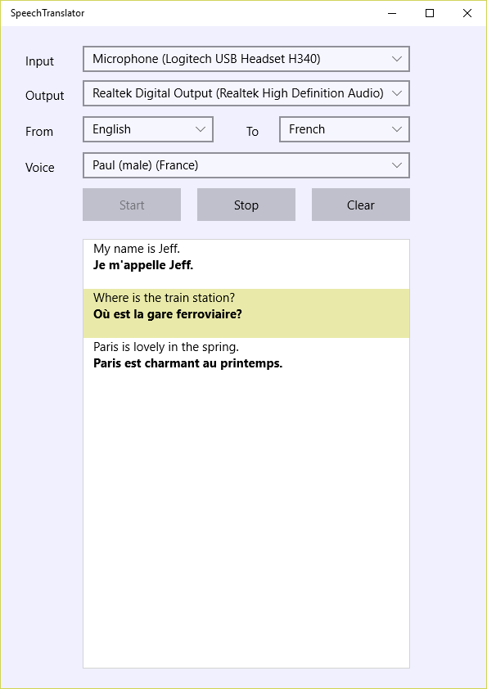
Translator API
Uses WebSockets to translate speech in real time
Uses deep neural networks to translate, remove disfluencies, and identify profanity
Uses silence detection to frame "utterances"
Supports WAV and MP3
Notes:
Examples of "disfluencies" include hmms and coughs. Profanities can be ignored, marked, or deleted. The Translator API is the magic behind Skype Translator.

Slide 28
Enumerating Languages
using (var client = new HttpClient())
{
var uri =
"https://dev.microsofttranslator.com/languages?api-version=1.0&scope=text,speech";
var response = await client.GetAsync(uri);
var json = await response.Content.ReadAsStringAsync();
dynamic result = JObject.Parse(json); // JSON.NET
foreach (var s in result.speech) // Enumerate input languages
{
// s.Name holds identifier ("en-US") and s.Value.name holds name ("English")
}
foreach (var s in result.text) // Enumerate output languages
{
// s.Name holds identifier ("fr") and s.Value.name holds name ("French")
}
}
Notes:
Although not shown here, you can also enumerate the "voices" supported for text-to-speech by including "tts" in the "scope" query string parameter.

Slide 29
Connecting to the Translator Service
_socket = new MessageWebSocket();
_socket.MessageReceived += OnMessageReceived;
// Insert an access token into the Authorization header
var provider = new AzureAuthToken("subscription_key");
var token = await provider.GetAccessTokenAsync(); _socket.SetRequestHeader("Authorization", token);
// Connect to the service via the WebSocket
var uri = "wss://dev.microsofttranslator.com/speech/translate?from=en-US&to=fr&features=texttospeech&voice=fr-FR-Paul&api-version=1.0";
await _socket.ConnectAsync(new Uri(uri));
Notes:
The token is generated from the subscription key and transmitted in the Authorization header of the HTTP request. The token must be renewed every 10 minutes.

Slide 30
Receiving Data from the Translator Service
private void OnMessageReceived(MessageWebSocket sender,
MessageWebSocketMessageReceivedEventArgs args)
{
if (args.MessageType == SocketMessageType.Utf8) // Text translation
{
using (var reader = args.GetDataReader())
{
dataReader.UnicodeEncoding = Windows.Storage.Streams.UnicodeEncoding.Utf8;
var json = reader.ReadString(dataReader.UnconsumedBufferLength);
// TODO: Extract translated text from JSON output
}
}
else if (args.MessageType == SocketMessageType.Binary) // Generated audio
{
using (var reader = args.GetDataReader())
{
dataReader.ByteOrder = ByteOrder.LittleEndian;
// TODO: Retrieve WAV or MP3 audio from the DataReader
}
}
}

Slide 31
Demo
Translator API
Notes:
Show SpeechTranslator, which converts spoken text to other languages on the fly and reads them back.

Slide 32
Speech APIs
Bing Speech
Speaker Recognition
Custom Recognition
Convert speech to text in 20 languages
Convert text to speech in 20 languages
Use a speaker's voice to verify his or her identity
Use voice to identify a speaker from a list of known speakers
Create custom language models for the Speaker Recognition API
Create custom acoustic models, too

Slide 33
Converting Text to Speech
POST /synthesize HTTP/1.1
Host: speech.platform.bing.com
Content-Type: audio/wav; samplerate=8000
Authorization: Bearer ••••••••••••••••••••••••••••••••
X-Microsoft-OutputFormat: riff-8khz-8bit-mono-mulaw
Content-Type: text/plain; charset=utf-8
Host: speech.platform.bing.com
Content-Length: 197
<speak version='1.0' xml:lang='en-US'>
<voice xml:lang='en-US'
xml:gender='Female'
name='Microsoft Server Speech Text to Speech Voice (en-US, ZiraRUS)'>
Convert this text into audio for me
</voice>
</speak>
Notes:
The Authorization header contains a JSON Web Token (JWT) token that is generated from the subscription key and must be refreshed every 10 minutes. The response contains the generated audio (stream + codec). Currently, the maximum amount of audio returned for a given request must not exceed 15 seconds.

Slide 34
Speaker Verification (Voice Authentication)
Speaker Recognition API can authenticate voices
Step 1
Use verificationPhrases method to enumerate verification phrases
Step 2
Use verificationProfiles method to create a verification profile
Step 3
Use enroll method to add 3 or more enrollments to the profile using any of the supported phrases enumerated in Step 1
Step 4
Use verify method to verify a voice against the profile

Slide 35
Enumerating Verification Phrases
var client = new SpeakerVerificationServiceClient(subscription_key);
var phrases = await client.GetPhrasesAsync("en-us");
foreach (var phrase in phrases)
{
string text = phrase.Phrase; // e.g., "Houston, we have had a problem"
}
Notes:
This example uses the Microsoft.ProjectOxford.SpeakerRecognition package from Nuget to simplify coding.

Slide 36
Working with Verification Profiles
var client = new SpeakerVerificationServiceClient(subscription_key);
// Create a new profile
var response = await client.CreateProfileAsync("en-us");
Guid id = response.ProfileId;
// Enumerate existing profiles
var profiles = await client.GetProfilesAsync();
foreach (var profile in profiles)
{
Guid id = profile.ProfileId;
int enrollments = profile.EnrollmentsCount);
}

Slide 37
Adding an Enrollment to a Profile
var client = new SpeakerVerificationServiceClient(subscription_key);
var enrollment = await client.EnrollAsync(stream, id);
Stream containing single-channel, PCM-encoded, WAV audio with 16K bit rate and 16-bit depth
Verification profile ID

Slide 38
Verifying a Speaker
var client = new SpeakerVerificationServiceClient(subscription_key);
var response = await client.VerifyAsync(stream, id);
var result = response.Result.ToString(); // "Accept" or "Reject"
var confidence =
response.Confidence.ToString(); // "High," "Normal," or "Low"

Slide 39
Demo
Speaker Recognition API
Notes:
Show SpeakerVerifier, which verifies my identity using the spoken phrase "Houston, we have had a problem."

Slide 40
Search APIs
Bing
Autosuggest
Bing
Image Search
Bing
News Search
Bing
Video Search
Bing
Web Search
Provide intelligent type-ahead for searches
Search the Web for images
Retrieve thumbnails, image metadata, and more
Search the Web for news
Categorize searches by topics
Identify trending topics
Search the Web for videos
Retrieve thumbnails, video metadata, and more
Search the Web for anything
Optionally filter out adult content

Slide 41
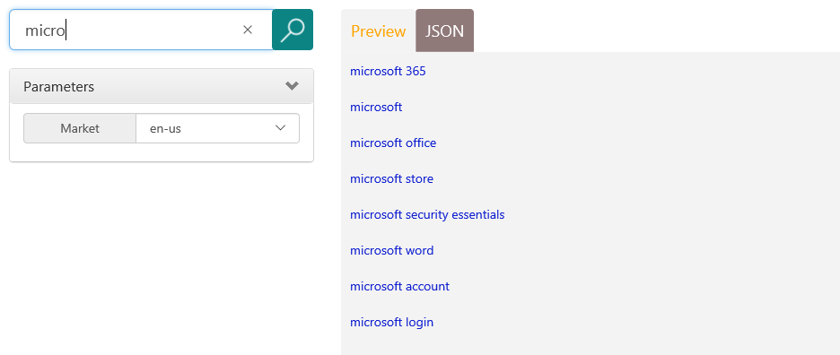
Bing Autosuggest API
Accepts a partial search term as input
Returns JSON-encoded list of suggested search terms, complete with links

Slide 42
Using the Bing Autosuggest API
var client = new HttpClient();
client.DefaultRequestHeaders.Add("Ocp-Apim-Subscription-Key",
"subscription_key");
var uri = "https://westus.api.cognitive.microsoft.com/" +
"bing/v5.0/suggestions&q=micro";
var response = await client.GetAsync(uri);
string json = await response.Content.ReadAsStringAsync();
dynamic result = JValue.Parse(json);
foreach (var suggestion in result.suggestionGroups[0].searchSuggestions)
{
Console.WriteLine(suggestion.displayText); // Output each suggestion
}

Slide 43
Get the Code
https://github.com/jeffprosise/Cognitive-Services

